Slide 1
Resume Maker
Present by:
Zijin Liu, Shuhan Li, Edward Shin, Paul O

Slide 2
Agenda
Introduction and overview
Product summary
Stakeholder analysis
Use cases
Tools used for the project
Functional and non-functional requirements
Demo
Future work and plans

Slide 3
Introduction and Overview
Resume Maker is the perfect site for anyone looking for a job. Our goal is to make an easy, and effective way to reduce the tedious task of making a resume from scratch. Here, you can find viable and relevant resume templates for our dream job
Login with your Google account credentials
Register with all information needed for a resume
Get templates with automated layouts
Get resumes preloaded with your information
Templates are free to download as pdf
Notes:
Edward

Slide 4
Product summary
Info collection: The first step in making a good resume is gathering info. The application will help you gather relevant certifications, history, and basic info, in a guided setup process.
Profile: With the information, user will see their own profile card on the index page
Templates: Once the information is gathered, the user will be presented with a selection of high quality templates. Resume templates will have high readability and need to fit everything necessary for the job application process. The template is then filled out and downloaded.
Contact Forum: The app provides a contact us section so that users can give possible feedback to improve the site’s functionality, maybe add new templates
Notes:
Zijin

Slide 5
Stakeholder analysis
Job candidates
  Students looking for an internship or co-op or professionals out in the workforce
  Reduce the tedious process of building a resume template from scratch
  Can put in information without worrying about forgotten information or sections
Notes:
Shuhan

Slide 6
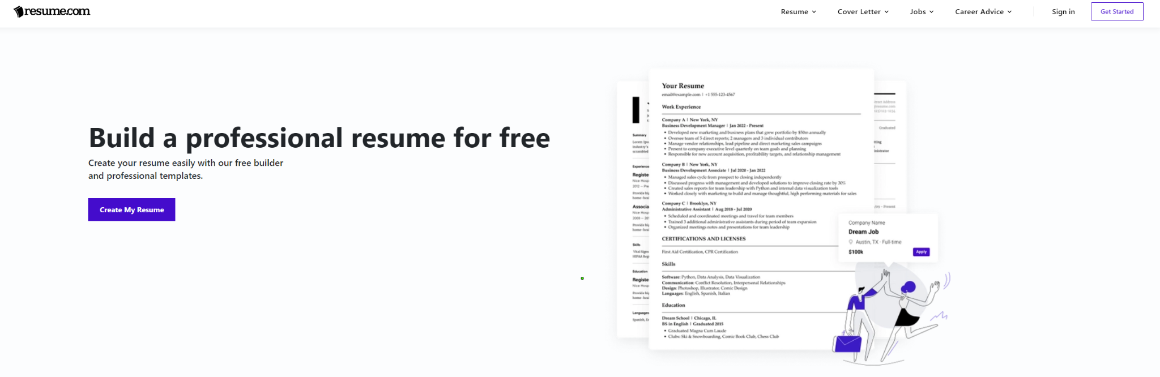
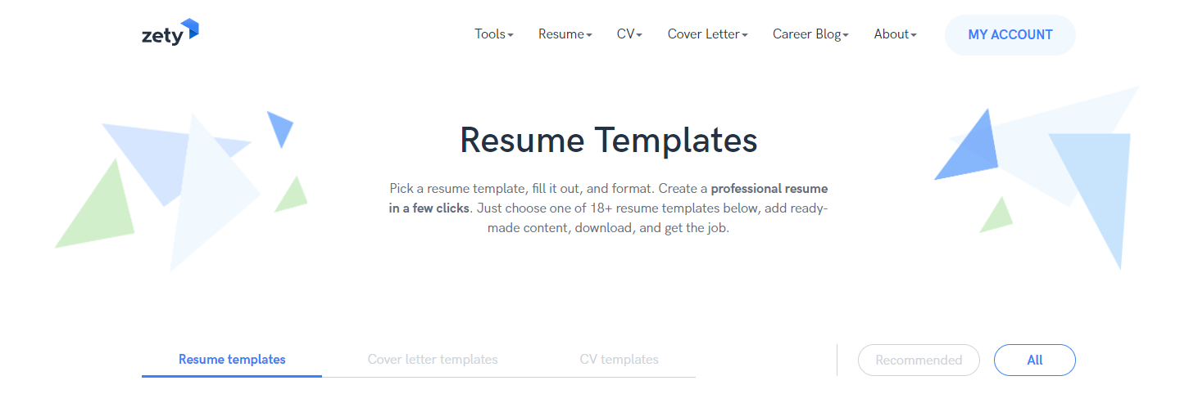
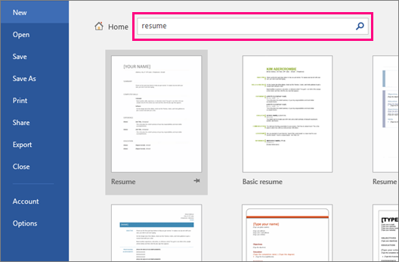
Competitors
Microsoft Resume Templates
Resume.com
Zety

Slide 7
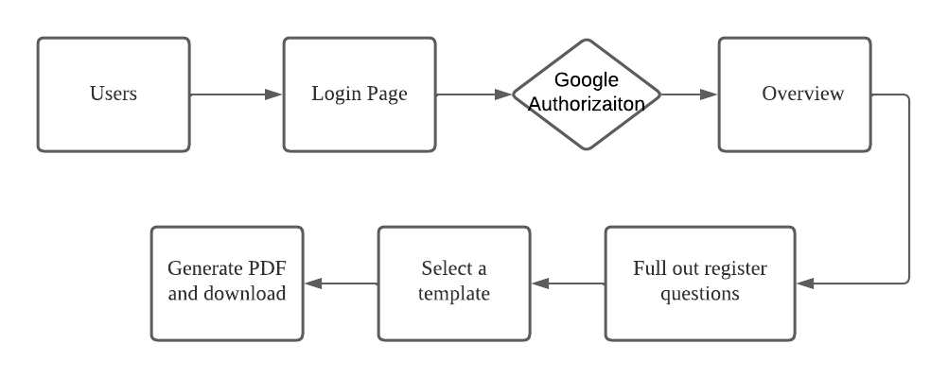
Use cases
Common Users
Notes:
Shuhan

Slide 8

Tools used for the project
Mongodb - Database to store documents
Express - node js framework, provides a set of features for easier development such as for routing
Angular - framework for building the application
Nodejs - Javascript runtime environment, REST API backend
Github
Notes:
Edward

Slide 9
Functional Requirements
Users
  Login page
  Filling out register questions
Templates
  Preview the preferred template as a page
  Provide different options
Database
  Stores users information
Notes:
Paul

Slide 10
Non-functional Requirements
User Interface
  Intuitive, clean, follow original website
Security
  Secure-wise, authenticated via Google OAuth
  Database safy
Notes:
Paul

Slide 11
Resume templates
Provides variety of templates with different layouts and styles
Able to see the template without login
With simple template, easy to understand and use
Build a resume in minutes.
Notes:
Zijin

Slide 12
Google Authentication (Firebase)
We use the Firebase SDK and a custom button that matches the design guidelines.
Google allows access to the email and users name so we use that for the register form
Notes:
Paul

Slide 13
Demo

Slide 14
Future Work
Update and add new templates
  Possibly allow users to suggest their own resume templates, after evaluation
Upload your resume so that recruiters can see directly from our site
Customize your own resume directly
Construct conversation with recruiter
Add filters when selecting resume
Ensure security of user information from database
Notes:
Edward

Slide 15
Thank you!
Any Questions?

